Slide 1
Chapter 3

Slide 2
Chapter Objectives
Distinguish among a variable, a named constant, and a literal constant
Explain how data is stored in memory
Select an appropriate name, data type, and initial value for a memory location
Declare a memory location in C++

Slide 3
Beginning Step 4 in the Problem-Solving Process
After Step 3, programmer has an algorithm and has desk-checked it
The fourth step in the process is coding the algorithm into a program
The step begins by assigning a descriptive name, data type, and (optionally) initial value to each unique input, processing, and output item in the IPO chart
These are used to store the item in the computer’s internal memory

Slide 4
Internal Memory
Computer’s internal memory is composed of memory locations, each with a unique numeric address
Similar to collection of storage bins
Each address can store one item at a time
Address can contain numbers, text, or program instructions
To use a memory location, programmer must reserve the address, called declaring

Slide 5
Internal Memory (cont’d.)
Declaring a memory location is done with an instruction that assigns a name, data type, and (optional) initial value
The name allows the programmer to refer to the memory location elsewhere in the program using a descriptive word, rather than the numeric address
The data type indicates what type of information the address will store (e.g., number or text)

Slide 6
Internal Memory (cont’d.)
Two types of memory locations can be declared: variables and named constants
Variables are memory locations whose values can change during runtime (when the program is running)
Most memory locations are variables
Named constants are memory locations whose values cannot change during program execution

Slide 7
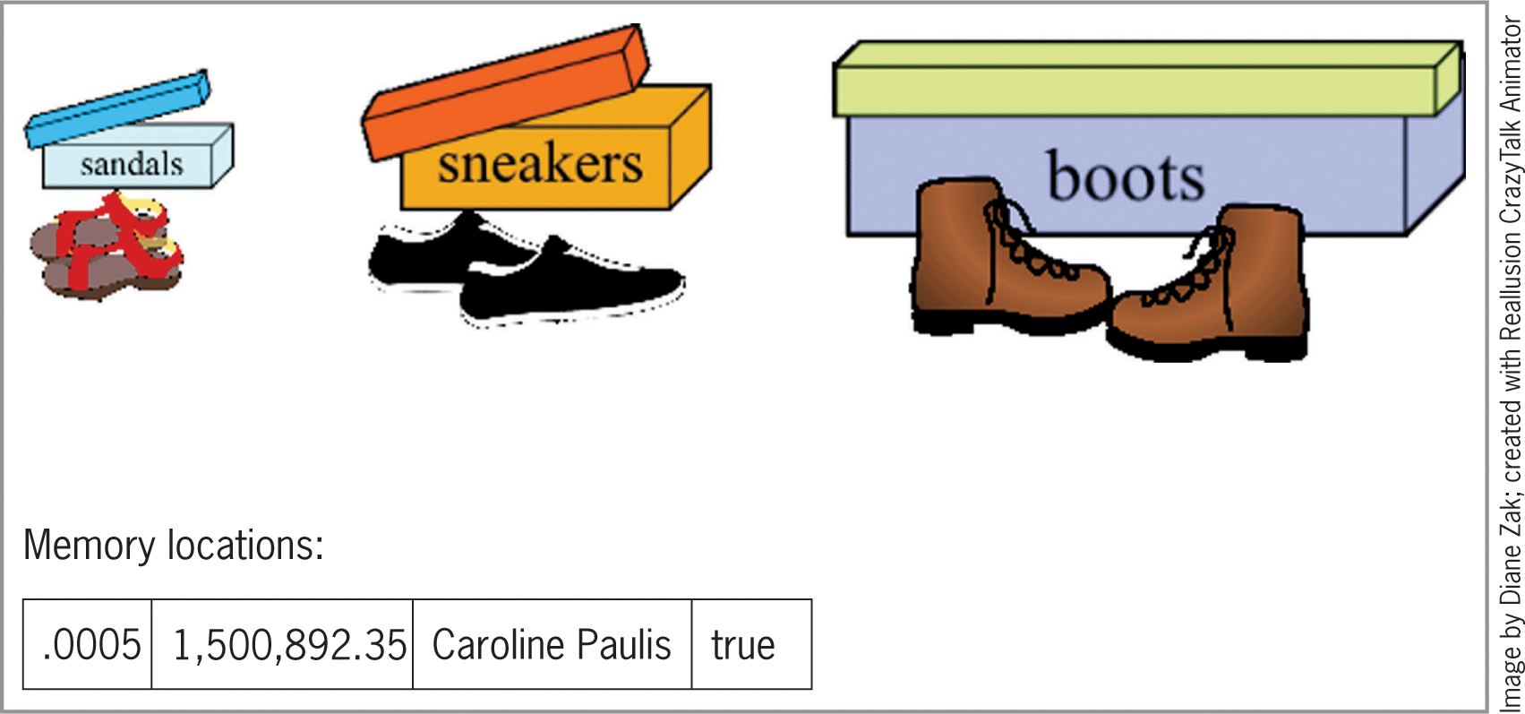
Internal Memory (cont’d.)
Figure 3-1 Illustration of show boxes and memory locations

Slide 8
Selecting a Name for a Memory Location
Name (identifier) assigned to a memory location should be descriptive
Should help the programmer/other programmers remember/understand the memory location’s purpose
Should be as short as possible while still being descriptive (especially if referenced often)
Short names are easier to read and result in more concise code

Slide 9
Selecting a Name for a Memory Location (cont’d.)
Rules for memory location names in C++
Name must begin with a letter and contain only letters, numbers, and the underscore character
No punctuation marks, spaces, or other special characters (such as $ or %) are allowed
Cannot be a keyword (word that has special meaning in C++)
Names are case sensitive
Example: discount is different from DISCOUNT and from Discount

Slide 10
Selecting a Name for a Memory Location (cont’d.)
Most programmers use uppercase letters for named constants and lowercase for variables
Example: PI (constant), radius (variable)
If constants contain more than one word, separate words with underscores
Example: TAX_RATE
If variables contain more than one word, capitalize the first letter of each word after the first (called camel case)
Example: adjustedGrossIncome

Slide 11
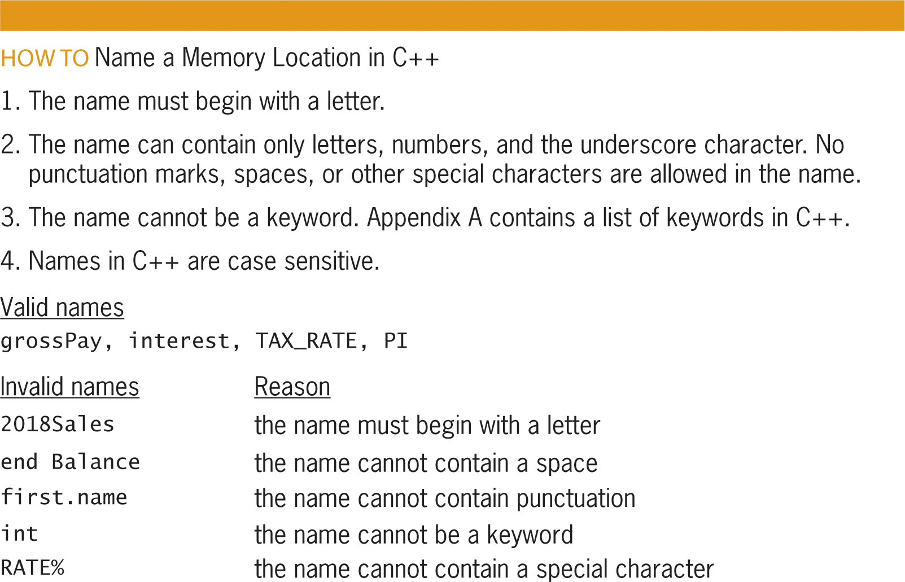
Selecting a Name for a Memory Location (cont’d.)
Figure 3-2 How to name a memory location in C++

Slide 12
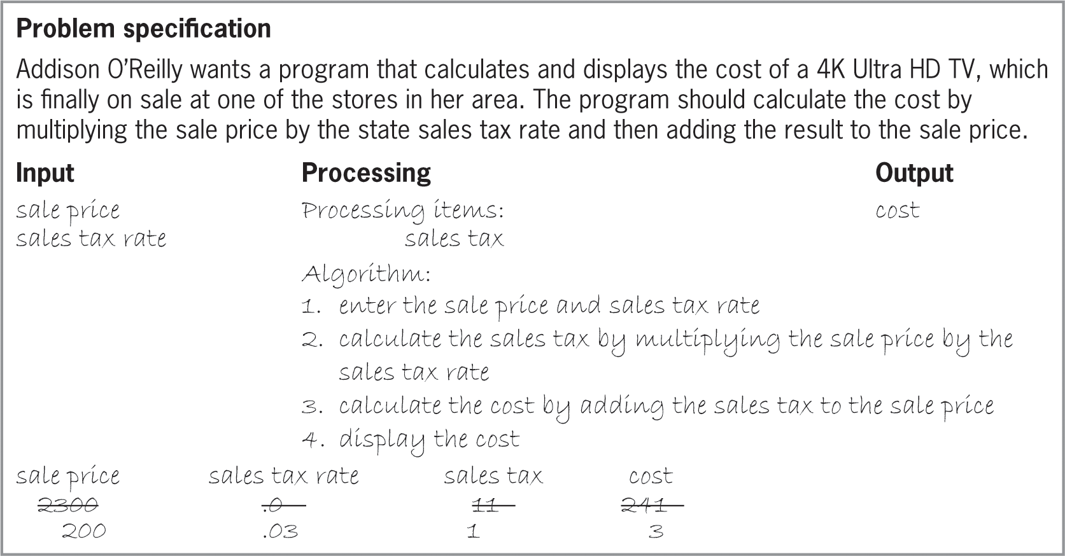
Revisiting the Addison O’Reilly Problem
Figure 3-3 Problem specification, IPO chart,
and desk-check table from Chapter 2

Slide 13
Revisiting the Addison O’Reilly Problem (cont’d.)
IPO chart contains four input, processing, and output items
Four memory locations are needed to store the values of the items
Memory locations will be variables since their values will change during runtime

Slide 14
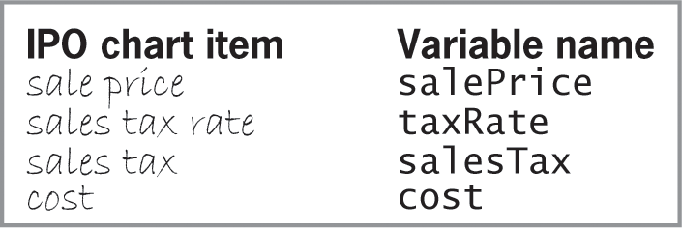
Revisiting the Addison O’Reilly Problem (cont’d.)
Figure 3-4 Names of the variables for the Addision O’Reilly problem

Slide 15
Selecting a Data Type for a Memory Location
Memory locations come in different types and sizes
Type and size you choose depends on the item you want to store
A memory location will only accept an item that matches its data type
Data type of a memory location is determined by the programmer when declaring the location

Slide 16
Selecting a Data Type for a Memory Location (cont’d.)
Fundamental data types are basic data types built into C++
Also called primitive or built-in data types
Include short, int, float, double, bool, and char
bool data type stores Boolean values (true and false)
short and int types store integers (numbers without a decimal place)
Differences are range of values and memory used (int has the greater of both)

Slide 17
Selecting a Data Type for a Memory Location (cont’d.)
float and double types store real numbers (numbers with a decimal place)
Differences are range of values, precision, and memory used (double has the greater of each)
char type stores characters (letter, symbol, or number that will not be used in a calculation)
Only one character stored at a time
string data type is a user-defined data type (defined with a class, or group of instructions)
Can store zero or more characters

Slide 18
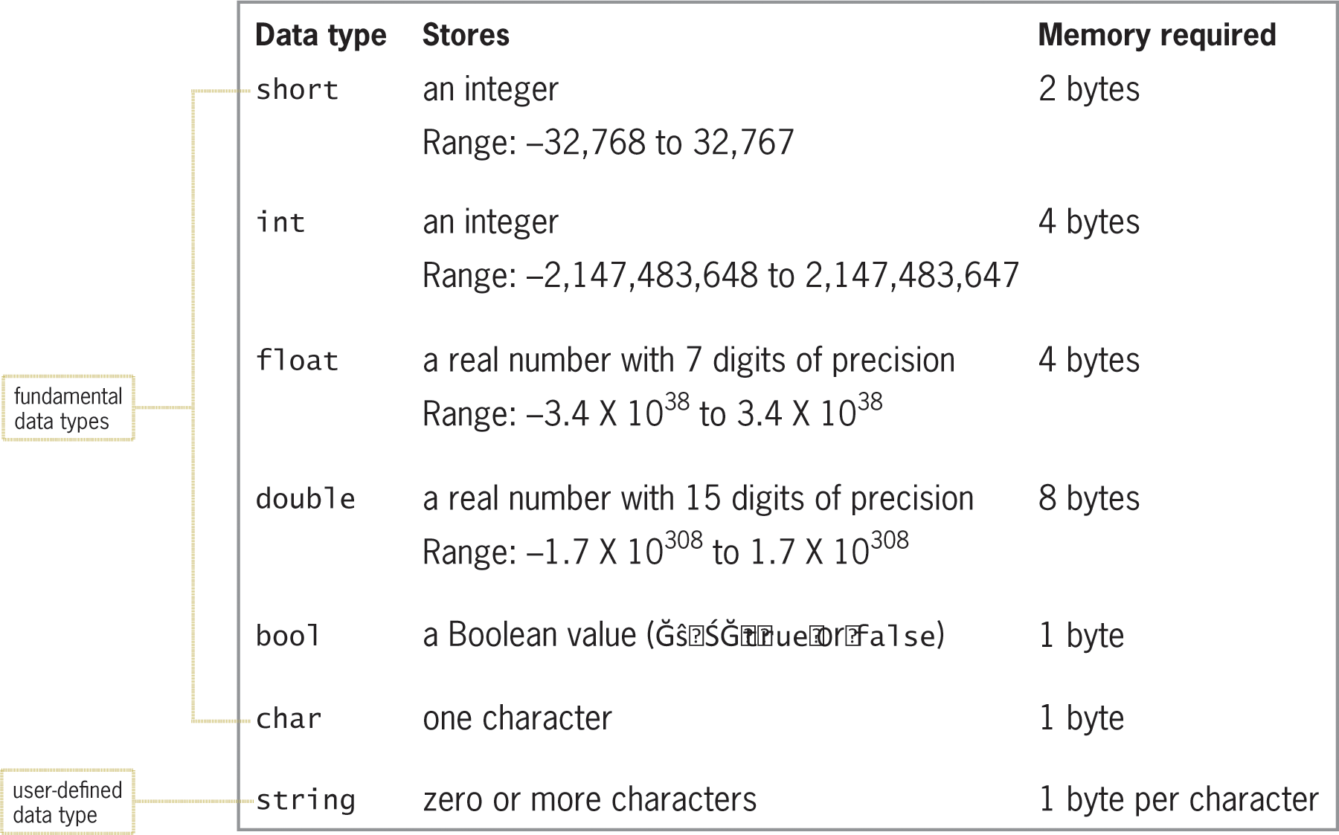
Selecting a Data Type for a Memory Location (cont’d.)
Figure 3-5 Most commonly used data types in C++

Slide 19
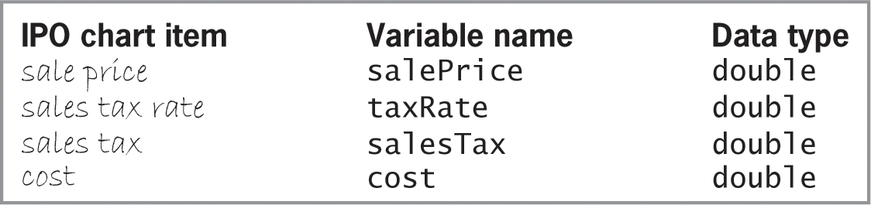
Selecting a Data Type for a Memory Location (cont’d.)
Figure 3-6 Data type assigned to each
variable for the Addison O’Reilly problem

Slide 20
How Data Is Stored in Internal Memory
Numbers represented in internal memory using binary (base 2) number system (two digits, 0 and 1)
We are used to the decimal (base 10) number system (ten digits, 0 through 9)
Character data is stored using ASCII codes
Eight-bit codes (bit = binary digit, 0 or 1)
Upper- and lowercase versions of letters have distinct codes
Computer distinguishes between numbers and ASCII codes based on data type

Slide 21
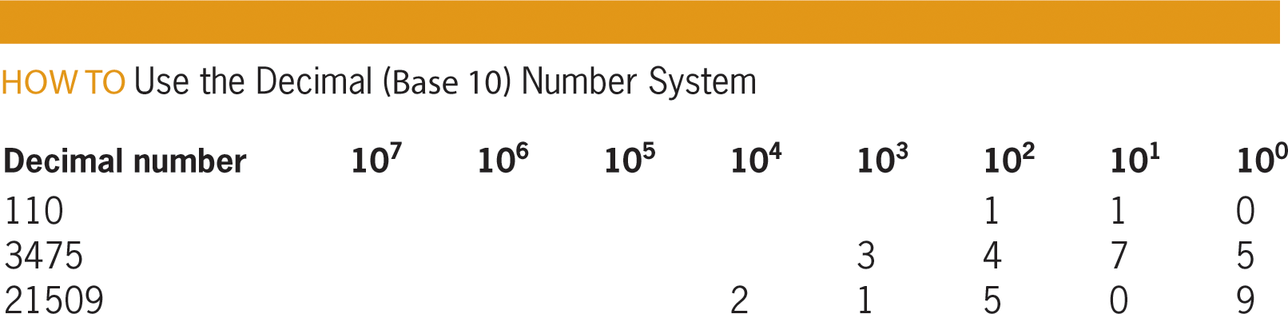
How Data Is Stored in Internal Memory (cont’d.)
Figure 3-7 How to use the decimal (base 10) number system

Slide 22
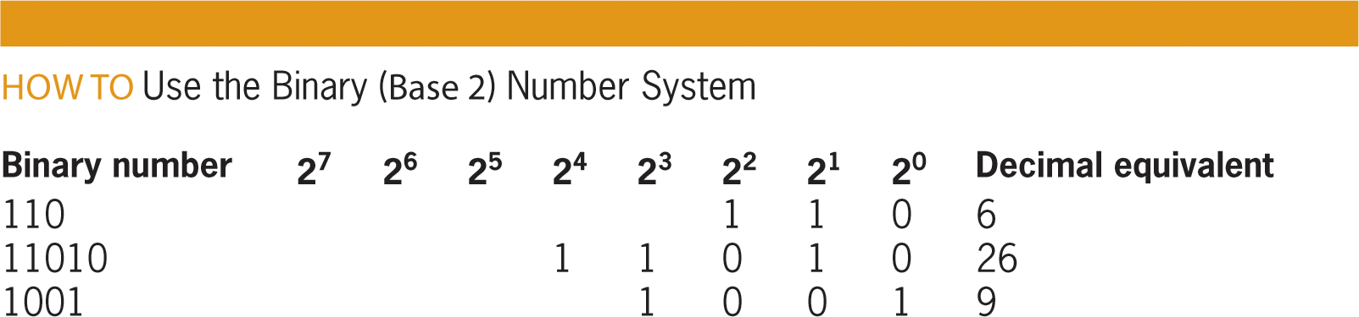
How Data Is Stored in Internal Memory (cont’d.)
Figure 3-8 How to use the binary (base 2) number system

Slide 23
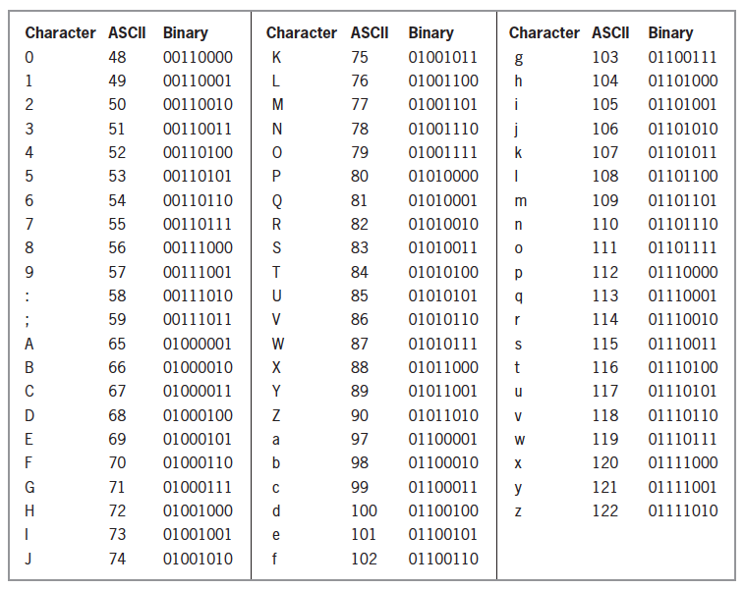
How Data Is Stored in Internal Memory (cont’d.)
Figure 3-9 Partial ASCII chart

Slide 24
Selecting an Initial Value for a Memory Location
Setting an initial value for a variable or named constant is called initializing
Required for constants; recommended for variables
Memory locations are usually initialized with a literal constant (item of data that can appear in a program instruction and be stored in memory)
Data type of literal constant should match data type of memory location it is assigned to

Slide 25
Selecting an Initial Value for a Memory Location (cont’d.)
Numeric literal constants initialize short, int, float, and double data types
Can contain digits 0 through 9, +, -, ., and e or E (for scientific notation)
Character literal constants initialize char data types
Consist of one character in single quotation marks
String literal constants initialize string data types
Zero or more characters enclosed in double quotation marks
Empty string (“”) is a valid string literal constant

Slide 26
Selecting an Initial Value for a Memory Location (cont’d.)
Before assigning initial value to a memory location, computer checks that value’s data type matches location’s data type
If they don’t match, computer performs implicit type conversion to match them
If initial value is converted to type that holds larger numbers, value is promoted
If initial value is converted to type that only holds smaller numbers, value is demoted
Promoting will not usually have adverse effects, but demoting can (information is lost)

Slide 27
Selecting an Initial Value for a Memory Location (cont’d.)
Important to initialize memory locations with values of the same data type
Named constants should be initialized with the value they will hold for the duration of the program
Variables whose initial values are not known should still be initialized
short and int types usually initialized to 0
float and double types usually initialized to 0.0
string types usually initialized to empty string (“”)
bool types initialized to either true or false

Slide 28
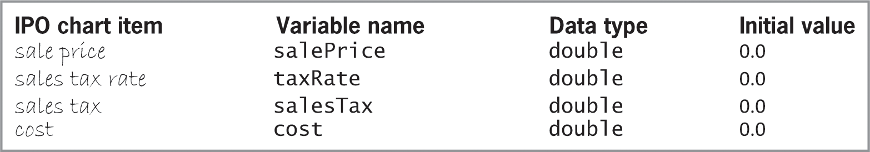
Selecting an Initial Value for a Memory Location (cont’d.)
Figure 3-11 Initial values for the variables
in the Addison O’Reilly problem

Slide 29
Declaring a Memory Location
Variables and named constants are declared using a statement (C++ instruction)
A statement that declares a variable causes the computer to set aside a memory location with the given name, data type, and initial value
Statements must follow correct syntax (rules of a programming language)
In C++, all statements must end with a semicolon

Slide 30
Declaring a Memory Location (cont’d.)
When declaring variables, a data type and name must be provided
Syntax for declaring a variable in C++
dataType variableName [= initialValue];
After variable is declared, you use its name to refer to it later in the program
Initial value is optional but recommended
If variable is not initialized, it contains the previous value of that memory location, which may be the wrong type (called a garbage value)

Slide 31
Declaring a Memory Location (cont’d.)
Syntax for declaring a named constant in C++
const dataType constantName = value;
The const keyword indicates that the memory location is a named constant (value cannot be changed during runtime)
Initial value required for constants, unlike variables
As with variables, after declaring a constant, you can use its name to refer to it later in the program

Slide 32
Declaring a Memory Location (cont’d.)
Several advantages to using named constants when appropriate
Make program more self-documenting (meaningful words in place of numbers)
Value cannot be inadvertently changed during runtime
Typing a name is less error-prone than a long number
Mistyping a constant’s name will trigger a compiler error; mistyping a number will not
If the constant needs to be changed when modifying the program, it only needs to be changed in one place

Slide 33
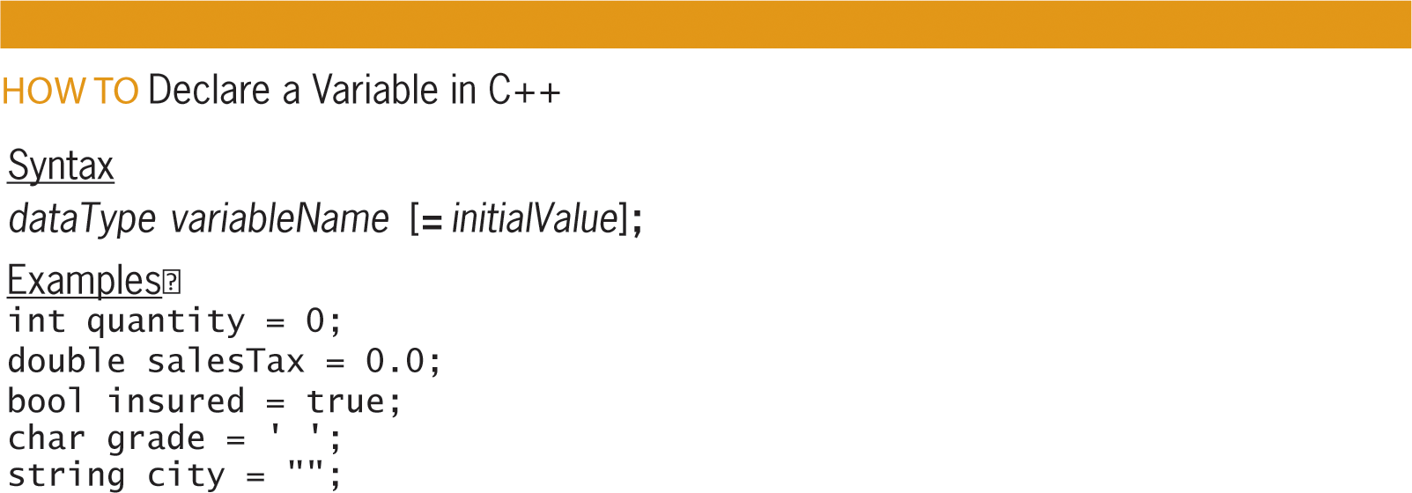
Declaring a Memory Location (cont’d.)
Figure 3-12 How to declare a variable in C++

Slide 34
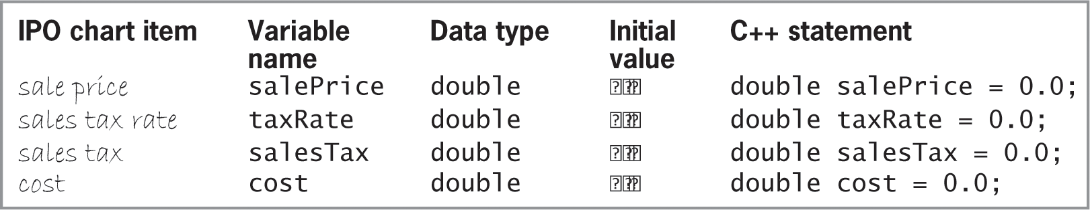
Declaring a Memory Location (cont’d.)
Figure 3-13 C++ declaration statements for the
variables in the Addision O’Reilly problem

Slide 35
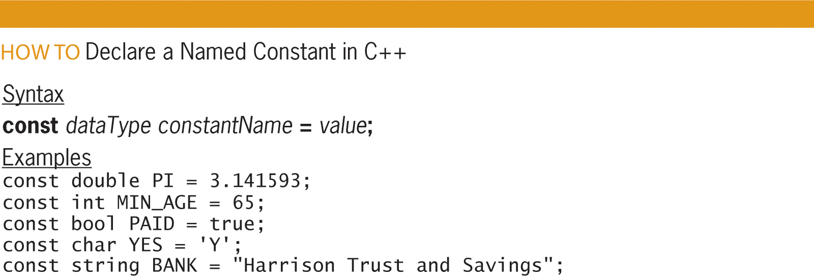
Declaring a Memory Location (cont’d.)
Figure 3-14 How to declare a named constant in C++

Slide 36
Summary
Fourth step in problem-solving process is coding the algorithm
Memory location is declared for each input, processing, and output item in IPO chart
Numeric data is stored in computer’s internal memory using binary number system
Memory locations store one item at a time
Memory location’s data type determines how a value is stored and interpreted when retrieved

Slide 37
Summary (cont’d.)
Two types of memory locations: variables and named constants
Memory locations are declared using a statement that assigns a name, data type, and initial value
Initial value required for named constants but optional for variables (though recommended)
Most memory locations initialized with literal constants, except bool (initialized with keywords true or false)

Slide 38
Summary (cont’d.)
Data type of literal constant assigned to memory location should be same as memory location’s type
If types don’t match, implicit type conversion is used to either promote or demote so they match
Promoting doesn’t usually cause problems, but demoting can
Syntax for declaring variables
dataType variableName [= initialValue];
Syntax for declaring named constants
const dataType constantName = value;

Slide 39
Lab 3-1: Stop and Analyze
Study the IPO chart shown in Figure 3-15 on page 64 and answer the questions below.
How many memory locations will the problem require?
How many of the memory locations will be variables, and how many will be named constants? Why did you choose one over the other?
How would you write the appropriate declaration statements? Use the int data type for the quantity sold, and the double data type for the remaining items.

Slide 40
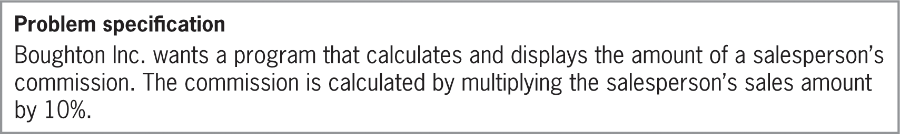
Lab 3-2: Plan and Create
Figure 3-16 Problem specification for Lab 3-2

Slide 41

Lab 3-2: Plan and Create (cont’d.)
Figure 3-17 Partially completed IPO chart showing input and output items

Slide 42
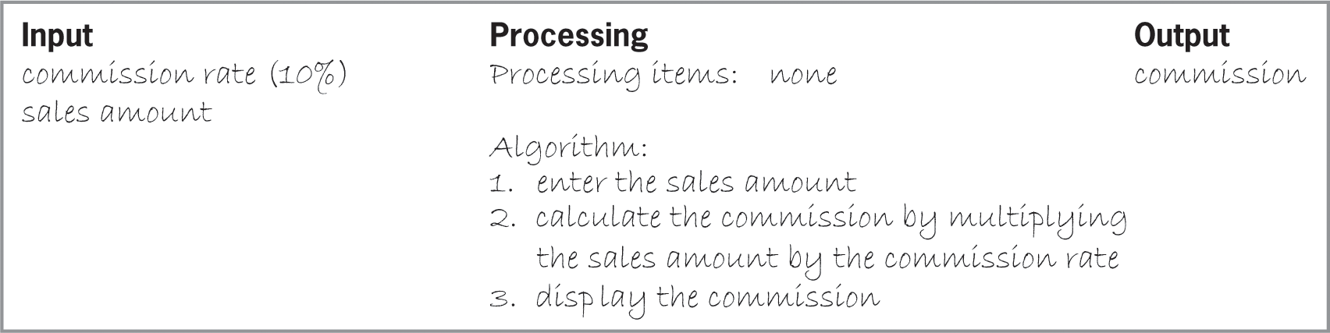
Lab 3-2: Plan and Create (cont’d.)
Figure 3-18 Completed IPO chart for Lab 3-2

Slide 43
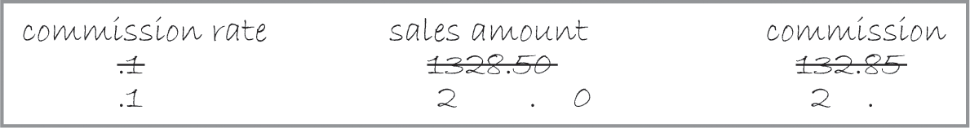
Lab 3-2: Plan and Create (cont’d.)
Figure 3-20 Completed desk-check table for Lab 3-2

Slide 44
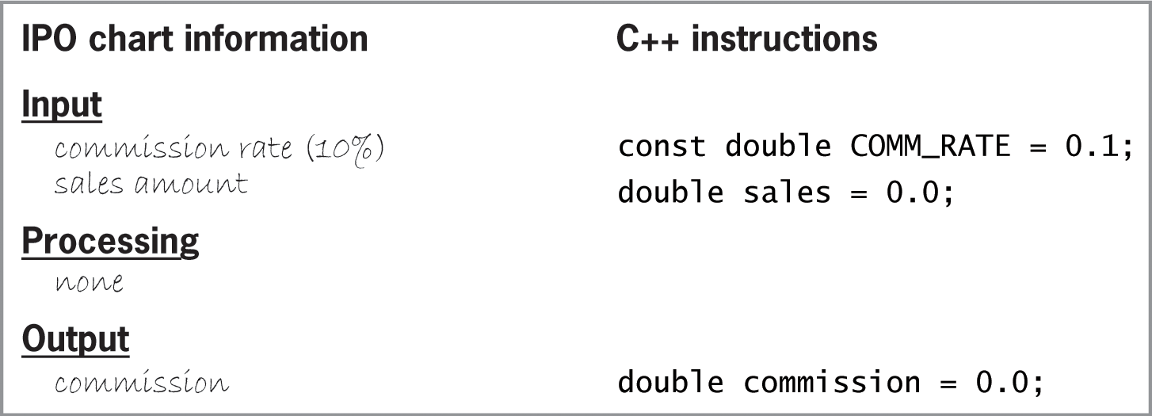
Lab 3-2: Plan and Create (cont’d.)
Figure 3-21 IPO chart information and C++ instructions for Lab 3-2

Slide 45
Lab 3-3: Modify
Modify the IPO chart in Figure 3-18 so that it allows the user to enter the commission rate. Then make the appropriate modifications to Figure 3-21.
Figure 3-18 Completed IPO chart for Lab 3-2

Slide 46
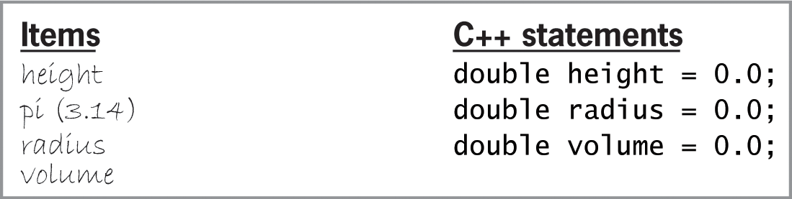
Lab 3-4: What’s Missing?
Professor Merrita wants a program that calculates and displays the volume of a cylinder, given the cylinder’s radius (r) and height (h). Given the items listed below in Figure 3-22, create a complete IPO chart similar to Figure 3-21 for the problem.
Figure 3-22 Items and statements for Lab 3-4

Slide 47
Lab 3-5: Desk-Check
After creating an appropriate algorithm for Lab 3-4, desk-check it twice. Use 9 and 6 as the height and radius fro the first desk-check, then use 17 and 15.

Slide 48
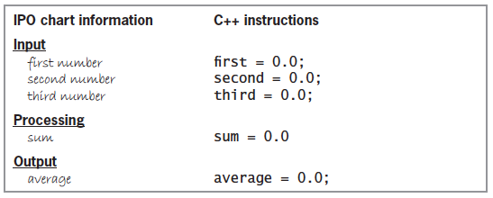
Lab 3-6: Debug
Correct the C++ instructions shown in Figure 3-23
The memory locations will store real numbers
Figure 3-23 IPO chart information and C++ instructions for Lab 3-6

